Slide 1
Lecture 12: Sequential Logic
Design with Flip-flops
Introduction
Flip-flop Characteristic Tables
Sequential Circuit Analysis
Flip-flop Input Functions
Analysis: Example #2
Analysis: Example #3
Flip-flop Excitation Tables
CS1104-12
Lecture 12: Sequential Logic: Design with Flip-flops

Slide 2
Lecture 12: Sequential Logic
Design with Flip-flops
Sequential Circuit Design
Design: Example #1
Design: Example #2
Design: Example #3
Design of Synchronous Counters
CS1104-12
Lecture 12: Sequential Logic: Design with Flip-flops

Slide 3
Introduction
Sequential circuits has an extra dimension – time.
Combinational circuit output depends only on the present inputs
Sequential circuit output depends on the history of past inputs as well
More powerful than combinational circuit, able to model situations that cannot be modeled by combinational circuits
Building blocks of synchronous sequential logic circuits: gates and flip-flops.
Flip-flops make up the memory M while the gates form one or more combinational subcircuits C₁, C₂, …, C_{q}.
CS1104-12
Models of Sequential Circuits

Slide 4
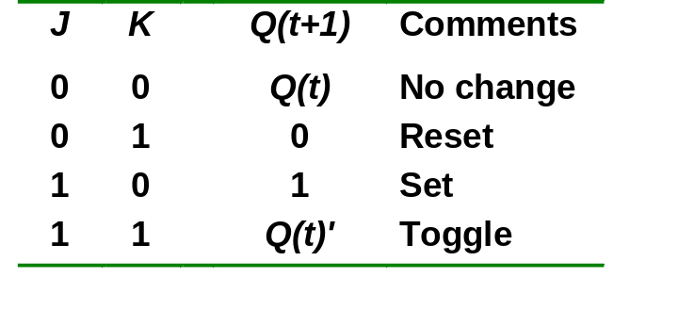
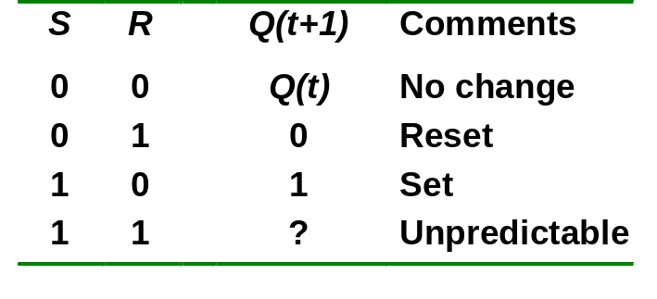
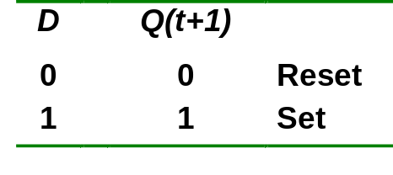
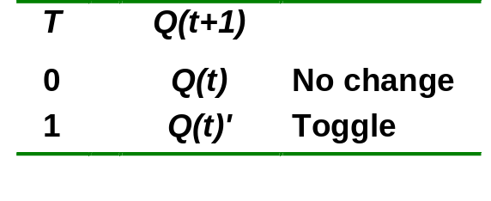
Flip-flop Characteristic Tables
Each type of flip-flop has its own behavior. The characteristic tables for the various types of flip-flops are shown below:
JK Flip-flop
SR Flip-flop
D Flip-flop
T Flip-flop
CS1104-12
Flip-flop Characteristic Tables

Slide 5
Sequential Circuit Analysis
Given a sequential circuit diagram, analyze its behaviour by deriving its state table and hence its state diagram.
Requires state equations to be derived for the flip-flop inputs, as well as output functions for the circuit outputs other than the flip-flops (if any).
We use A(t) and A(t+1) to represent the present state and next state, respectively, of a flip-flop represented by A.
Alternatively, we could simply use A and A⁺ for the present state and next state respectively.
CS1104-12
Sequential Circuit Analysis

Slide 6
Sequential Circuit Analysis
Example (using D flip-flops):
State equations:
A⁺ = A.x + B.x
B⁺ = A'.x
Output function:
y = (A + B).x'
x
D
Q
A
Q'
A'
D
Q
B
Q'
B'
CP
y
Figure 1.
CS1104-12
Sequential Circuit Analysis

Slide 7
Sequential Circuit Analysis
From the state equations and output function, we derive the state table, consisting of all possible binary combinations of present states and inputs.
State table
  Similar to truth table.
  Inputs and present state on the left side.
  Outputs and next state on the right side.
m flip-flops and n inputs → 2^{m+n} rows.
CS1104-12
Sequential Circuit Analysis

Slide 8
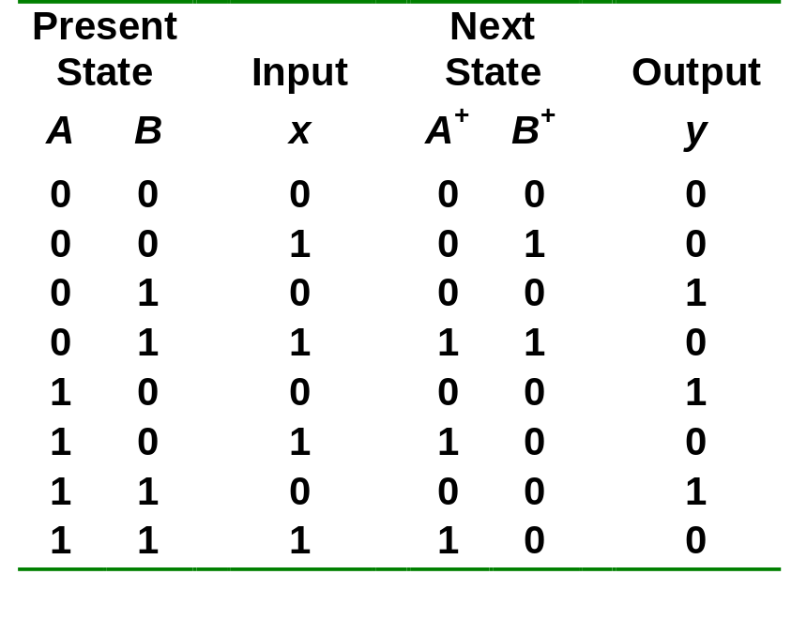
Sequential Circuit Analysis
State table for the circuit of Figure 1:
State equations:
A⁺ = A.x + B.x
B⁺ = A'.x
Output function:
y = (A + B).x'
CS1104-12
Sequential Circuit Analysis

Slide 9
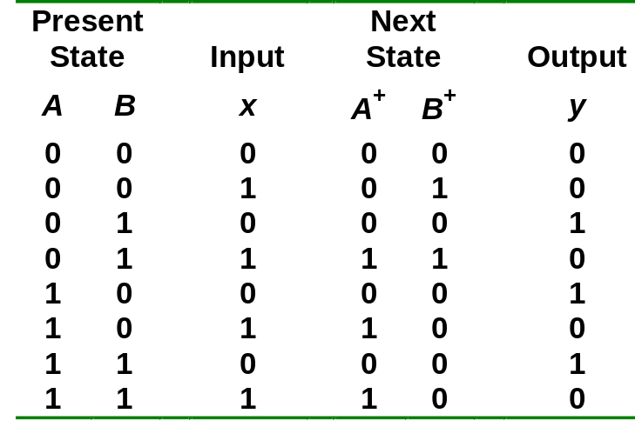
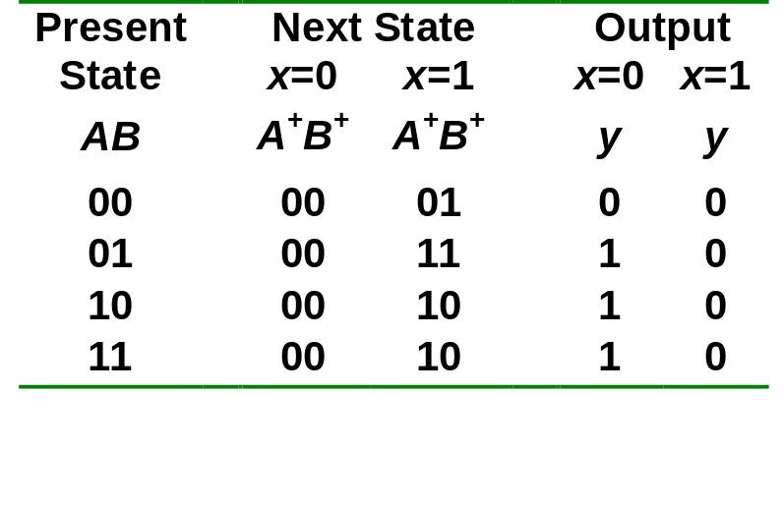
Sequential Circuit Analysis
Alternate form of state table:
CS1104-12
Sequential Circuit Analysis

Slide 10
Sequential Circuit Analysis
From the state table, we can draw the state diagram.
State diagram
  Each state is denoted by a circle.
  Each arrow (between two circles) denotes a transition of the sequential circuit (a row in state table).
  A label of the form a/b is attached to each arrow where a denotes the inputs while b denotes the outputs of the circuit in that transition.
Each combination of the flip-flop values represents a state. Hence, m flip-flops → up to 2^{m} states.
CS1104-12
Sequential Circuit Analysis

Slide 11
Sequential Circuit Analysis
State diagram of the circuit of Figure 1:
0/0
1/0
0/1
00
10
1/0
0/1
0/1
1/0
01
1/0
11
CS1104-12
Sequential Circuit Analysis

Slide 12
Flip-flop Input Functions
The outputs of a sequential circuit are functions of the present states of the flip-flops and the inputs. These are described algebraically by the circuit output functions.
  In Figure 1: y = (A + B).x'
The part of the circuit that generates inputs to the flip-flops are described algebraically by the flip-flop input functions (or flip-flop input equations).
The flip-flop input functions determine the next state generation.
From the flip-flop input functions and the characteristic tables of the flip-flops, we obtain the next states of the flip-flops.
CS1104-12
Flip-flop Input Functions

Slide 13
Flip-flop Input Functions
Example: circuit with a JK flip-flop.
We use 2 letters to denote each flip-flop input: the first letter denotes the input of the flip-flop (J or K for JK flip-flop, S or R for SR flip-flop, D for D flip-flop, T for T flip-flop) and the second letter denotes the name of the flip-flop.
B
C'
x
JA = B.C'.x + B'.C.x’
KA = B + y
B'
C
x'
J
Q
A
B
y
K
Q'
CP
CS1104-12
Flip-flop Input Functions

Slide 14
Flip-flop Input Functions
In Figure 1, we obtain the following state equations by observing that Q⁺ = DQ for a D flip-flop:
  A⁺ = A.x + B.x (since DA = A.x + B.x)
  B⁺ = A'.x (since DB = A'.x)
x
D
Q
A
Q'
A'
D
Q
B
CP
Q'
B'
Figure 1.
y
CS1104-12
Flip-flop Input Functions

Slide 15
Analysis: Example #2
Given Figure 2, a sequential circuit with two JK flip-flops A and B, and one input x.
Obtain the flip-flop input functions from the circuit:
  JA = B JB = x'
  KA = B.x' KB = A'.x + A.x' = A ⊕ x
J
Q
A
x
K
Q'
J
Q
B
K
Q'
Figure 2.
CP
CS1104-12
Analysis: Example #2

Slide 16
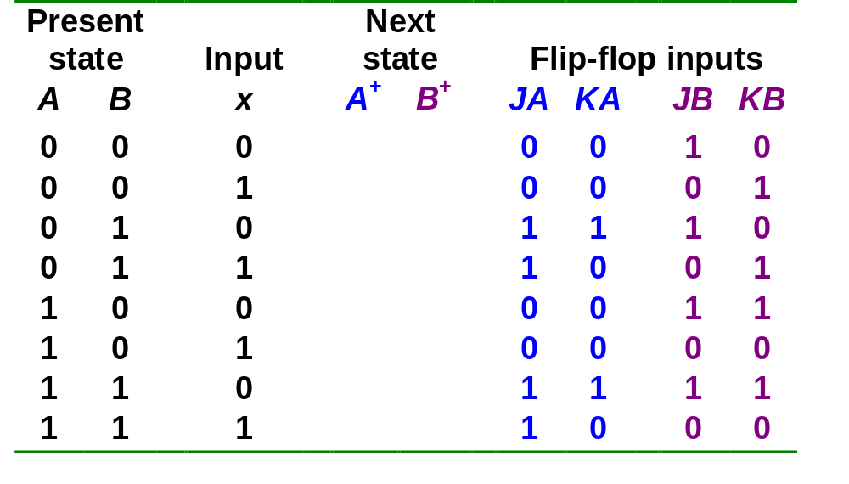
Analysis: Example #2
Flip-flop input functions:
  JA = B JB = x'
  KA = B.x' JB = A'.x + A.x' = A ⊕ x
Fill the state table using the above functions, knowing the characteristics of the flip-flops used.
0 1
0 0
1 1
1 0
1 1
1 0
0 0
1 1
CS1104-12
Analysis: Example #2

Slide 17
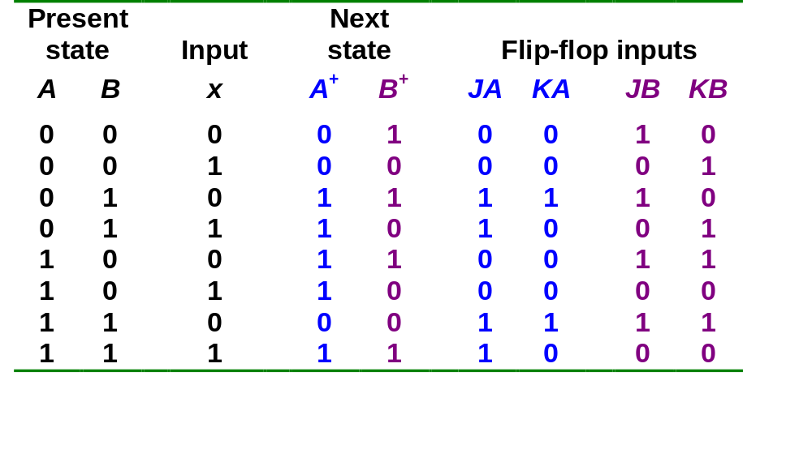
Analysis: Example #2
Draw the state diagram from the state table.
1
1
0
11
00
0
0
0
01
1
10
1
CS1104-12
Analysis: Example #2

Slide 18
Analysis: Example #3
Derive the state table and state diagram of the following circuit.
Flip-flop input functions:
  JA = B JB = KB = (A ⊕ x)' = A.x + A'.x'
  KA = B'
J
Q
A
J
Q
B
K
Q'
K
Q'
CP
y
x
Figure 3.
CS1104-12
Analysis: Example #3

Slide 19
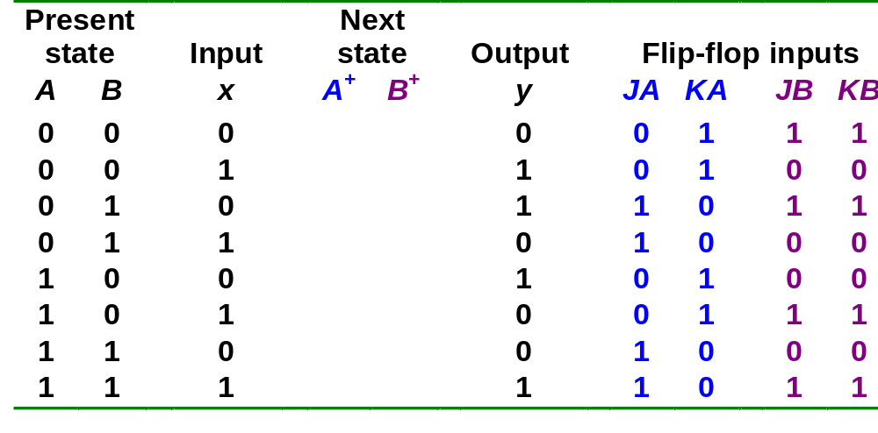
Analysis: Example #3
Flip-flop input functions:
  JA = B JB = KB = (A ⊕ x)' = A.x + A'.x'
  KA = B'
State table:
0 1
0 0
1 0
1 1
0 0
0 1
1 1
1 0
CS1104-12
Analysis: Example #3

Slide 20
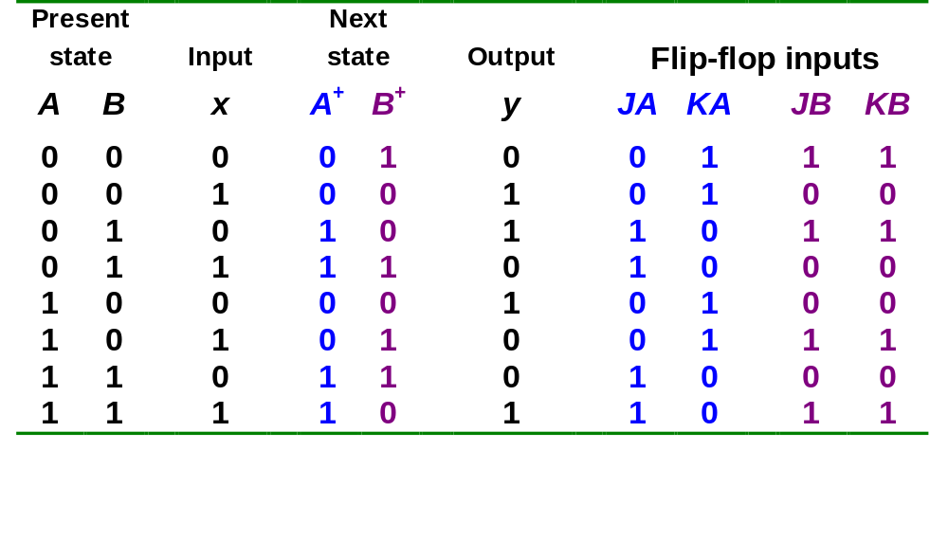
Analysis: Example #3
State diagram:
1/1
00
0/1
10
0/0
0/1
1/1
1/0
01
1/0
11
0/0
CS1104-12
Analysis: Example #3

Slide 21
Flip-flop Excitation Tables
Analysis: Starting from a circuit diagram, derive the state table or state diagram.
Design: Starting from a set of specifications (in the form of state equations, state table, or state diagram), derive the logic circuit.
Characteristic tables are used in analysis.
Excitation tables are used in design.
CS1104-12
Flip-flop Excitation Tables

Slide 22
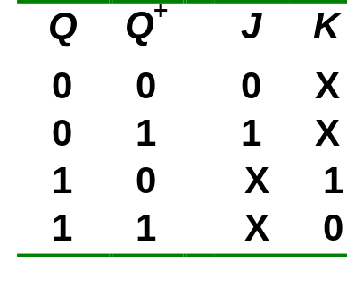
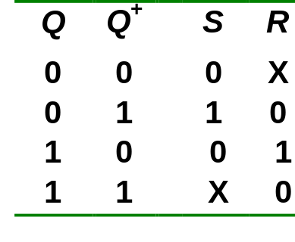
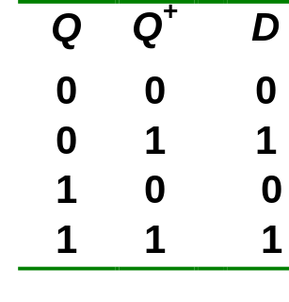
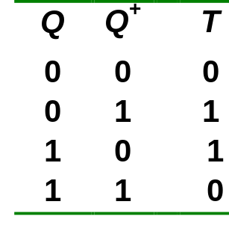
Flip-flop Excitation Tables
Excitation tables: given the required transition from present state to next state, determine the flip-flop input(s).
JK Flip-flop
SR Flip-flop
D Flip-flop
T Flip-flop
CS1104-12
Flip-flop Excitation Tables

Slide 23
Sequential Circuit Design
Design procedure:
  Start with circuit specifications – description of circuit behaviour.
  Derive the state table.
  Perform state reduction if necessary.
  Perform state assignment.
  Determine number of flip-flops and label them.
  Choose the type of flip-flop to be used.
  Derive circuit excitation and output tables from the state table.
  Derive circuit output functions and flip-flop input functions.
  Draw the logic diagram.
CS1104-12
Sequential Circuit Design

Slide 24
Design: Example #1
Given the following state diagram, design the sequential circuit using JK flip-flops.
0
00
1
1
1
01
11
0
0
1
10
0
CS1104-12
Design: Example #1

Slide 25
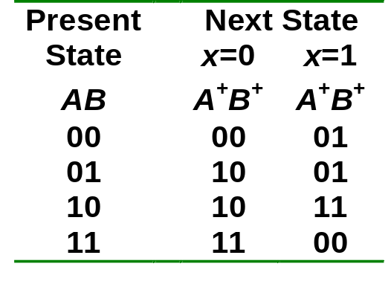
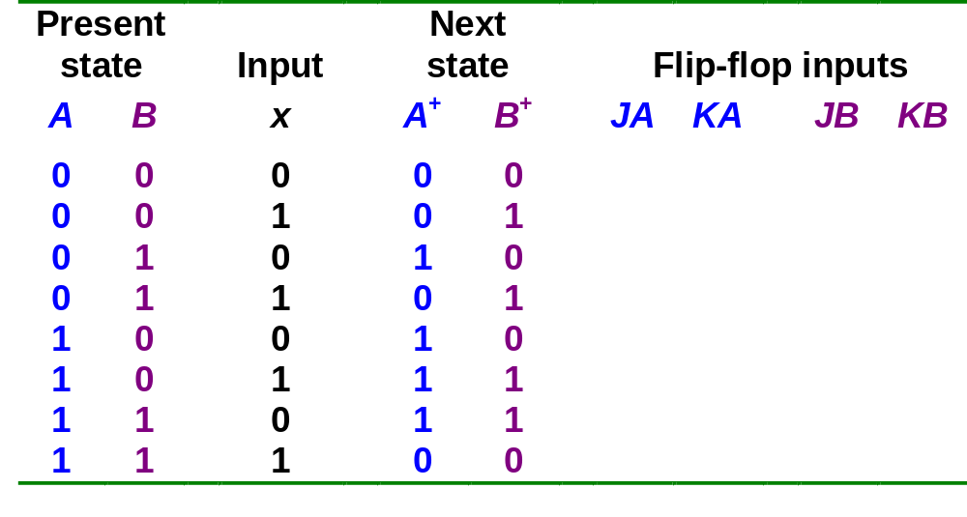
Design: Example #1
Circuit state/excitation table, using JK flip-flops.
0
00
1
1
1
01
11
0
0
1
10
0
0 X
0 X
1 X
X 1
X 0
0 X
1 X
X 0
X 1
0 X
1 X
0 X
X 0
JK Flip-flop’s
excitation table.
X 0
X 0
X 1
CS1104-12
Design: Example #1

Slide 26
Design: Example #1
Block diagram.
A’
A
B’
B
Q'
Q
Q'
Q
K
J
K
J
CP
KA
JA
KB
JB
A'
Combinational
circuit
A
External
output(s)
(none)
B
B'
x
External
input(s)
What are to go in here?
CS1104-12
Design: Example #1

Slide 27
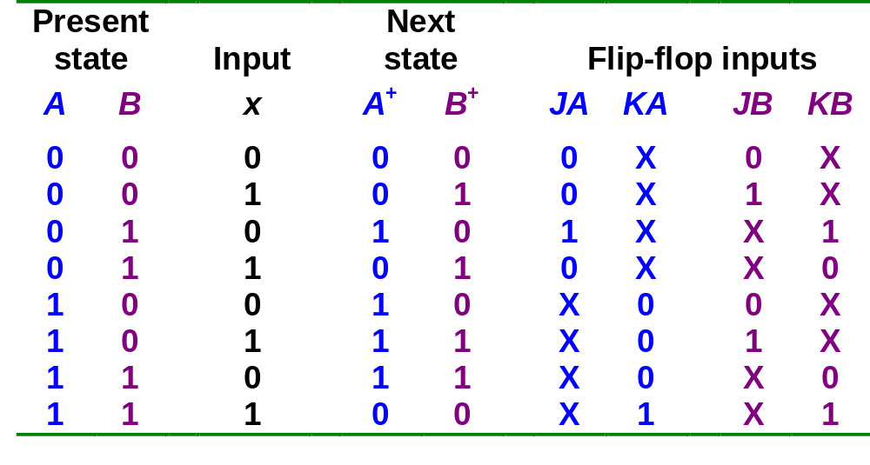
Design: Example #1
From state table, get flip-flop input functions.
Bx
B
A
00 01 11 10
0
1
1
A
X
X
X
X
x
JA = B.x'
Bx
B
A
00 01 11 10
B
B
0
1
X
X
X
X
Bx
Bx
A
00 01 11 10
A
00 01 11 10
A
1
0
1
1
X
X
0
1
X
X
1
x
A
1
X
X
A
X
X
1
KA = B.x
x
x
JB = x
KB = (A ⊕ x)'
CS1104-12
Design: Example #1

Slide 28
Design: Example #1
Flip-flop input functions.
JA = B.x' JB = x
KA = B.x KB = (A ⊕ x)'
Logic diagram:
A
B
Q'
Q
Q'
Q
K
J
K
J
CP
x
CS1104-12
Design: Example #1

Slide 29
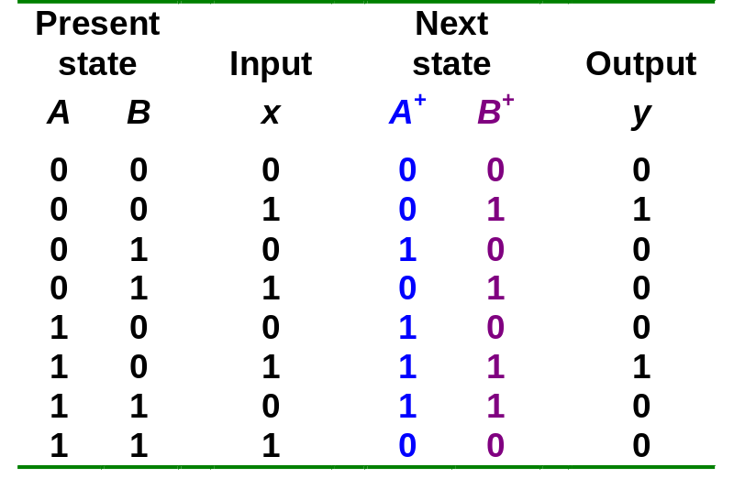
Design: Example #2
Design, using D flip-flops, the circuit based on the state table below. (Exercise: Design it using JK flip-flops.)
CS1104-12
Design: Example #2

Slide 30
Design: Example #2
Determine expressions for flip-flop inputs and the circuit output y.
Bx
B
A
00 01 11 10
0
1
1
DA = A.B' + B.x'
A
1
1
1
x
Bx
B
A
00 01 11 10
0
1
1
1
DB = A'.x + B'.x + A.B.x'
A
1
1
x
Bx
B
DA(A, B, x) = Σ m(2,4,5,6)
DB(A, B, x) = Σ m(1,3,5,6)
y(A, B, x) = Σ m(1,5)
A
00 01 11 10
0
1
1
y = B'.x
A
1
x
CS1104-12
Design: Example #2

Slide 31
Design: Example #2
From derived expressions, draw logic diagram:
DA = A.B' + B.x'
DB = A'.x + B'.x + A.B.x'
y = B'.x
D
Q
A
x
A'
Q'
D
Q
B
Q'
B'
CP
y
CS1104-12
Design: Example #2

Slide 32
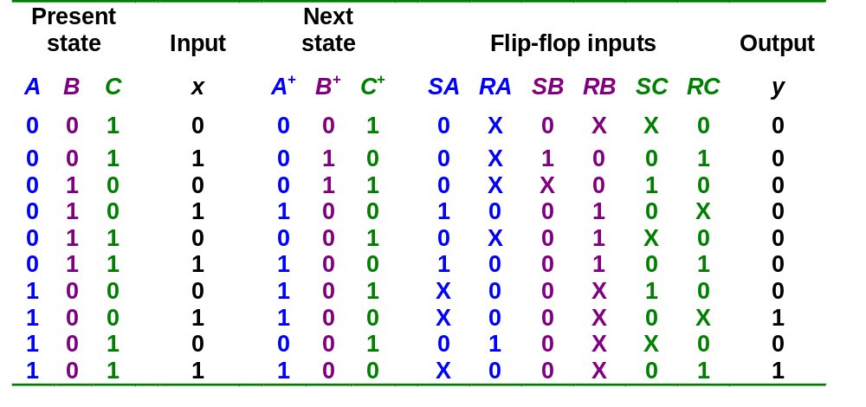
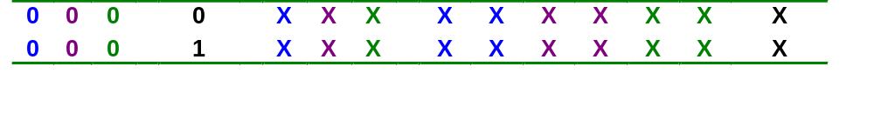
Design: Example #3
Design with unused states.
Given these
Derive these
Unused state 000:
CS1104-12
Design: Example #3

Slide 33
Design: Example #3
From state table, obtain expressions for flip-flop inputs.
Cx
C
Cx
C
AB
00 01 11 10
AB
00 01 11 10
00
01
11
10
X
X
00
01
11
10
X
X
X
X
1
1
X
X
B
B
X
X
X
X
X
X
X
X
A
A
SA = B.x
X
X
X
1
RA = C.x'
x
x
Cx
C
Cx
C
AB
00 01 11 10
AB
00 01 11 10
00
01
11
10
X
X
1
00
01
11
10
X
X
X
X
1
1
1
B
B
X
X
X
X
X
X
X
X
A
A
RB = B.C + B.x'
SB = A'.B'.x
X
X
X
X
x
x
CS1104-12
Design: Example #3

Slide 34
Design: Example #3
From state table, obtain expressions for flip-flop inputs (cont’d).
Cx
C
Cx
C
AB
00 01 11 10
AB
00 01 11 10
00
01
11
10
X
X
X
00
01
11
10
X
X
1
1
X
X
1
B
B
X
X
X
X
X
X
X
X
A
A
SC = x'
1
X
X
1
RC = x
x
x
Cx
C
AB
00 01 11 10
00
01
11
10
X
X
B
X
X
X
X
A
1
1
y = A.x
x
CS1104-12
Design: Example #3

Slide 35
Design: Example #3
From derived expressions, draw logic diagram:
SA = B.x SB = A'.B'.x SC = x'
RA = C.x' RB = B.C + B.x' RC = x
y = A.x
y
x
S
Q
A
R
Q'
A'
S
Q
B
R
Q'
B'
S
Q
C
R
Q'
CP
CS1104-12
Design: Example #3

Slide 36
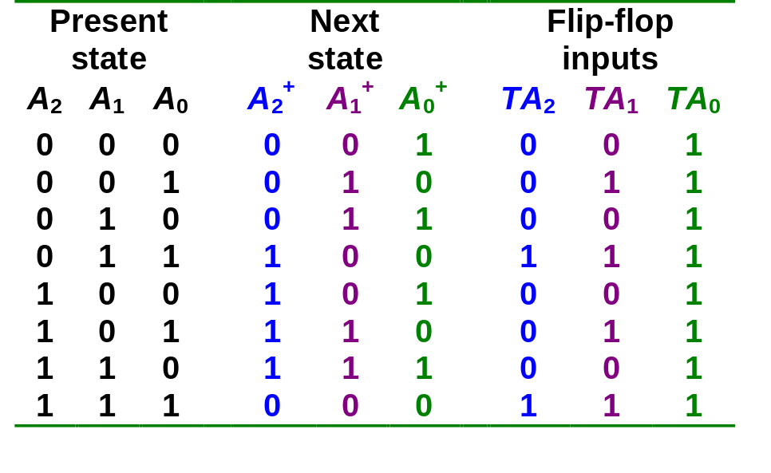
Design of Synchronous Counters
Counter: a sequential circuit that cycles through a sequence of states.
Binary counter: follows the binary sequence. An n-bit binary counter (with n flip-flops) counts from 0 to 2^{n}-1.
Example 1: A 3-bit binary counter (using T flip-flops).
000
001
111
010
110
011
101
100
CS1104-12
Design of Synchronous Counters

Slide 37
Design of Synchronous Counters
3-bit binary counter (cont’d).
A₁
A₁
A₁
1
1
1
1
1
1
1
A₂
1
A₂
1
1
A₂
1
1
1
1
A₀
A₀
A₀
TA₂ = A₁.A₀
TA₁ = A₀
TA₀ = 1
CS1104-12
Design of Synchronous Counters

Slide 38
Design of Synchronous Counters
3-bit binary counter (cont’d).
  TA₂ = A₁.A₀ TA₁ = A₀ TA₀ = 1
A₂
A₁
A₀
Q
Q
Q
T
T
T
CP
1
CS1104-12
Design of Synchronous Counters

Slide 39
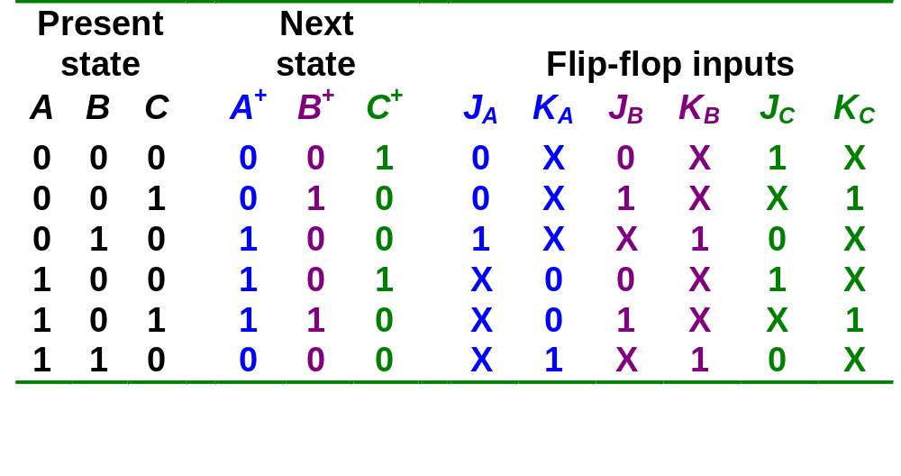
Design of Synchronous Counters
Example 2: Counter with non-binary sequence:
  000 → 001 → 010 → 100 → 101 → 110 and back to 000
000
001
110
010
101
100
J_{A} = B J_{B} = C J_{C} = B'
K_{A} = B K_{B} = 1 K_{C} = 1
CS1104-12
Design of Synchronous Counters

Slide 40
Design of Synchronous Counters
Counter with non-binary sequence (cont’d).
JA = B JB = C JC = B'
KA = B KB = 1 KC = 1
A
B
C
000
111
Q'
Q
Q'
Q
Q'
Q
001
110
K
J
K
J
K
J
CP
010
101
1
100
011
CS1104-12
Design of Synchronous Counters

Slide 41
Summary
Sequential circuits have memory and they are more powerful than combinational circuits.
Analyzing sequential circuits
  Flip-flop characteristic table
  State Table
  State diagram
Designing sequential circuits
  Flip-flop excitation table
  State assignment
  Circuit output function
  Flip-flop input function
CS1104-12
Summary

Slide 42
End of segment

